Slide 1

Metadata, controlled vocabularies, syllabus and learning objectives

Slide 2
Metadata and metadata schema

Slide 3
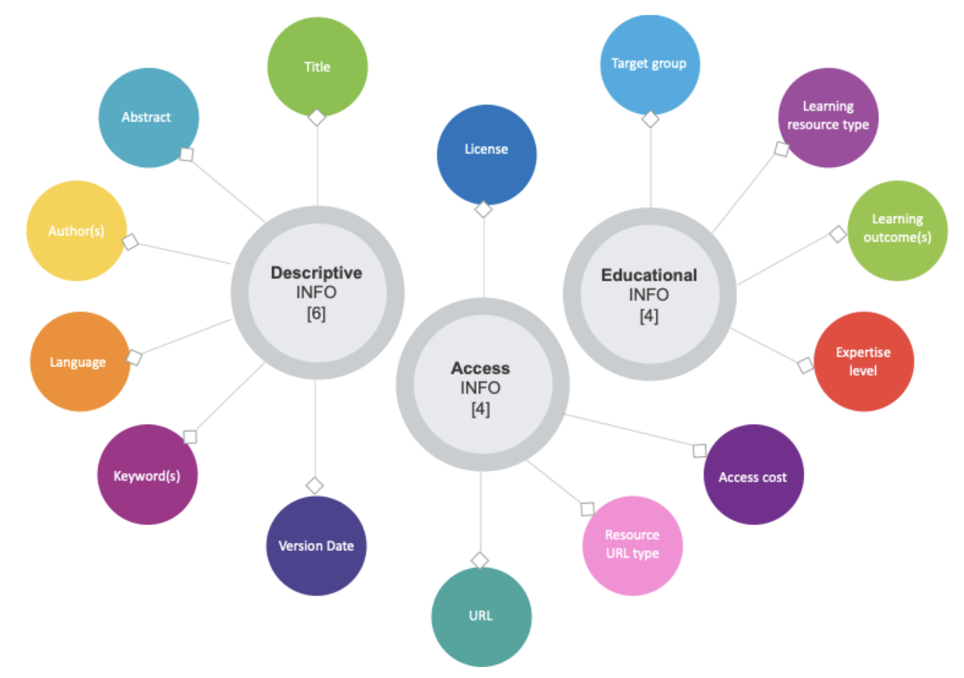
The RDA Minimal Metadata for Learning Resources
Image: Minimum set of metadata for learning resources
Taken from Hoebelheinrich, Nancy J, Biernacka, Katarzyna, Brazas, Michelle, Castro, Leyla Jael, Fiore, Nicola, Hellström, Margareta, Lazzeri, Emma, Leenarts, Ellen, Martinez Lavanchy, Paula Maria, Newbold, Elizabeth, Nurnberger, Amy, Plomp, Esther, Vaira, Lucia, van Gelder, Celia W G, & Whyte, Angus. (2022). Recommendations for a minimal metadata set to aid harmonised discovery of learning resources on Zenodo licensed under CC BY 4.0

Slide 4
Controlled vocabularies

Slide 5
Syllabus Elements
Title
Training Description
Target audience
Primary Language
Prerequisites
Duration
Certification Information
Author(s)
PID
Accessibility Mission
Type
Date/Time
Location
Expertise Level
Access Cost
Training objectives
Keywords
Agenda
Resources and Materials
Trainer(s)
Contact information
License

Slide 6
Defining learning objectives

Slide 7
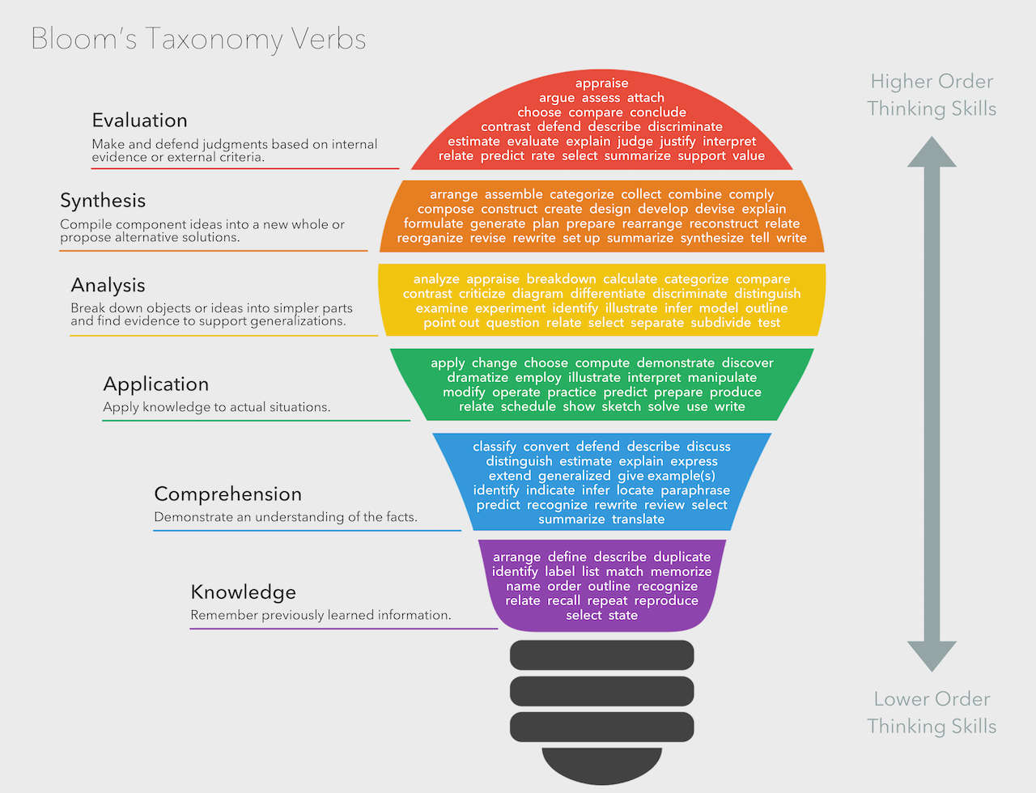
Learning Objectives Verbs
Bloom's taxonomy by Fractus Learning. (2023, July 10). In Wikipedia licensed under the terms of CC BY-SA 4.0.

Slide 8
FAIR-by-Design Methodology Details
Up-to-Date Methodology
https://fair-by-design-methodology.github.io/FAIR-by-Design_Book/
ToT course on Skills4EOSC LMS
https://learning.skills4eosc.eu/course/view.php?id=19
Training GitBook
https://fair-by-design-methodology.github.io/FAIR-by-Design_ToT/latest/
GitHub
https://github.com/FAIR-by-Design-Methodology/FAIR-by-Design_ToT

Slide 9

Help us improve
We are very interested in your thoughts and ideas
Let us co-create and make a new, improved, version of the FAIR-by-Design materials together

Slide 10


Thank you! Questions?
This presentation is released under a CC-BY 4.0 license. To cite this presentation, please copy and paste:
Filiposka, Sonja. (2023, December 4). FAIR-by-Design Methodology: How to Develop FAIR Materials. FAIR Implementation Workshop. FAIR-IMPACT Webinar. Zenodo
10.5281/zenodo.10256852

